Slide 1
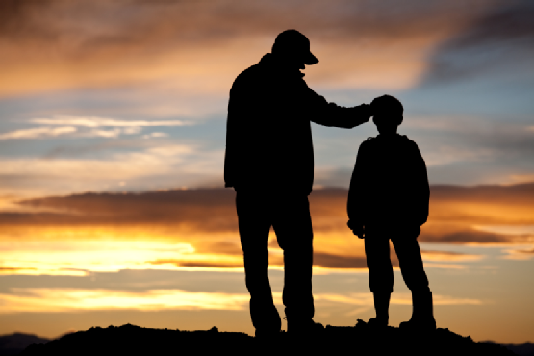
Faith of Our Fathers

Slide 2
Note: Any videos in this presentation will only play online. After you download the slideshow, you will need to also download the videos from YouTube & add them back into your PowerPoint.
We present these messages at Bee Creek Park in College Station, TX. If you would like to watch the video of the service with this message, click here:
http://campaignkerusso.org/?p=11695
We would love to know more about the people who download our lessons & sermons. We invite you to email us & let us know where & how you use them.
info@ckbrazos.org

Slide 3
Faith of Our Fathers

Slide 4
Next Slide → Song:
As for Me and My House
Download Here:
http://youtu.be/t2w_pGMVR-o

Slide 5
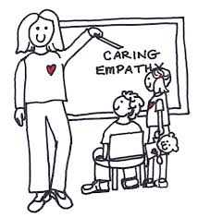
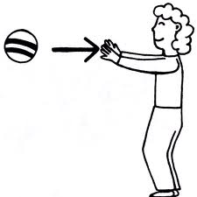
Faith of Our Fathers & Mothers About Generational Faith – It is…
Bought | Taught | Caught | Fought
“But from everlasting to everlasting, the LORD's mercy is on those who fear him. His righteousness belongs to their children and grandchildren.” Ps. 103:17

Slide 6
It is a free gift and is also inheritable in some ways.
The faith of our fathers & mothers is BOUGHT.

Slide 7
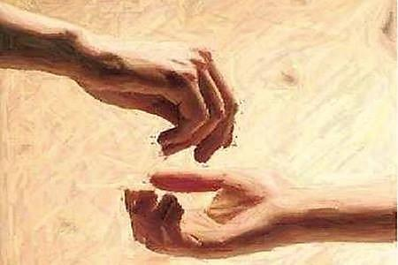
Our saving faith was bought by Jesus Christ & freely given to believers.
“…and at the cost of your own blood you have purchased for God persons from every tribe, language, people, and nation.” Rev. 5:
“God saved you by his grace when you believed. And you can't take credit for this;
it is a gift from God.” Eph. 2:8

Slide 8
God has no grandchildren; we must all embrace our own faith.
There is an inheritance of promise to the children of the faithful.
It is as an inheritance of promises passed to the children of the faithful.
“…good men’s sons have a special heritage.”
Ps. 112:2

Slide 9
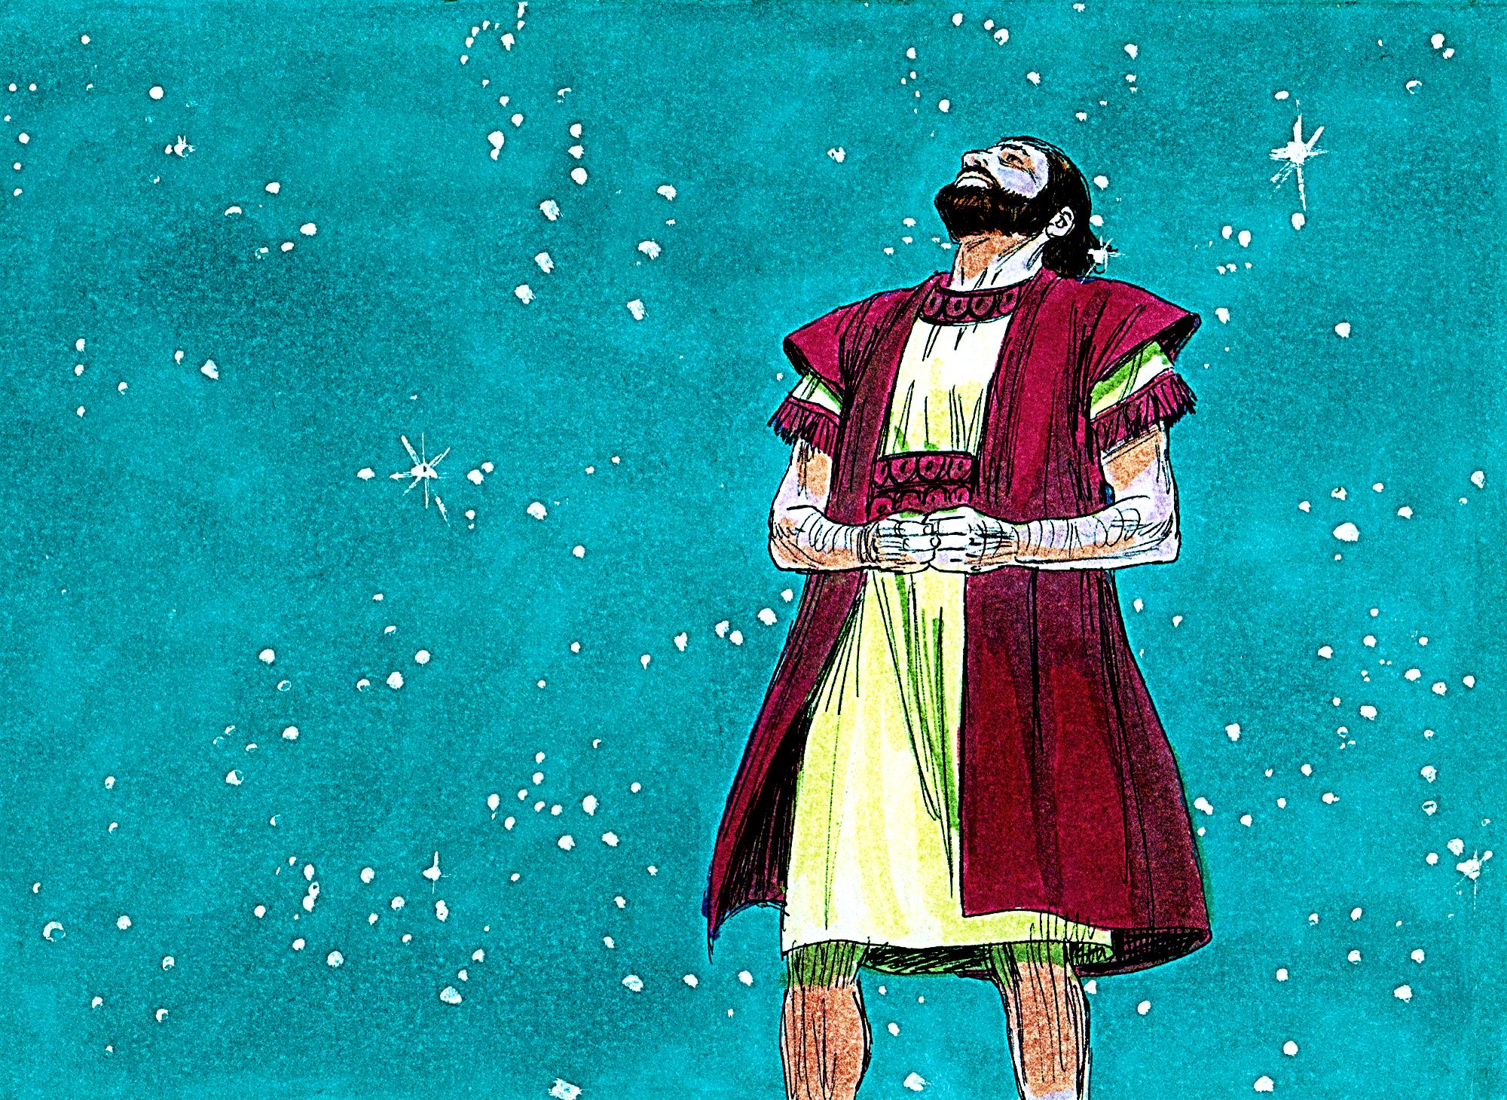
“I will make My agreement between Me and you and your children after you through their whole lives for all time. I will be God to you and to your children’s children after you.” Gen. 17:7

Slide 10
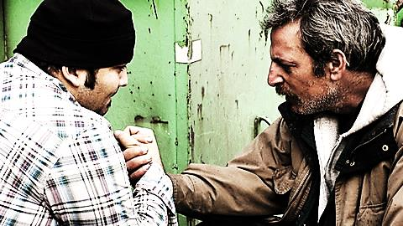
“See, I am going to the people of Israel, and I will say to them, ‘The God of your fathers has sent me to you…” Ex. 3:13
Long after they have left home, God continues to send His ministers to the children of the faithful.

Slide 11
But, it is an Inheritance dependent upon the heart of the child to embrace his parent’s promised blessings.
“Now, O Israel, listen to the Laws I am teaching you. Do them so that you may live and go in to take the land for your own that the Lord, the God of your fathers, is giving you.” Deut. 4:1

Slide 12
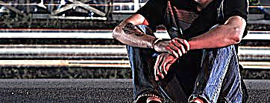
“How long will you wait before going in to take the land the Lord, the God of your fathers, has given you?” Josh. 18:3

Slide 13
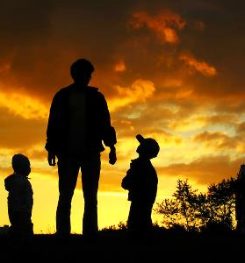
The Faith of our Fathers & Mothers is TAUGHT
“I have chosen him so he would command his children and his descendants to live the way the Lord wants them to, to live right... Gen. 18:19

Slide 14
“Fathers, do not be too hard on your children
so they will become angry. Teach them in their growing years with Christian teaching.” Eph. 6:4
Pro-active teaching is better than mere reactive scolding.

Slide 15
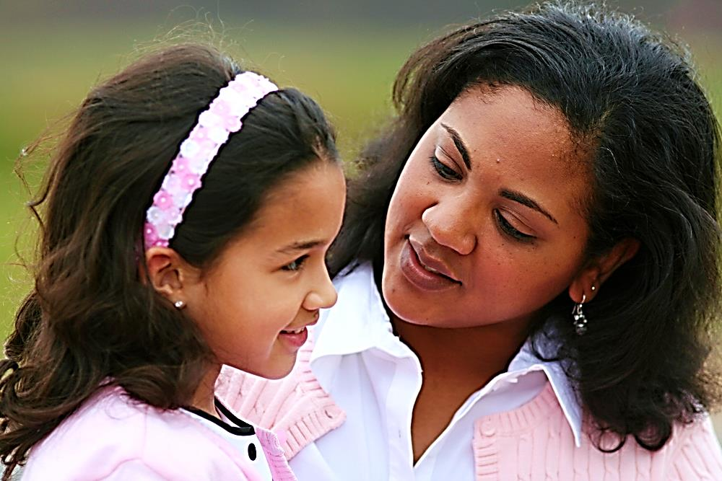
“Teach them to your children. Talk about them when you sit in your house and when you walk on the road and when you lie down and when you get up.” Deut. 11:19.

Slide 16
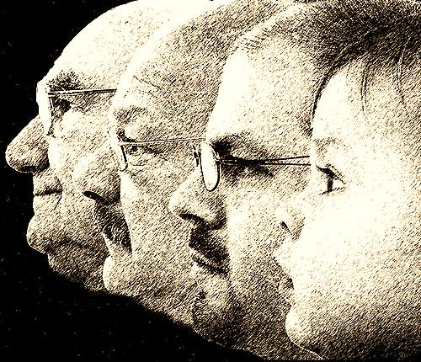
“…But we will tell the children-to-come the praises of the Lord, and of His power and the great things He has done... So the children-to-come might know, even the children yet to be born. So they may rise up and tell it to their children…” Ps. 78:4-6

Slide 17
“But you, Timothy, must keep on doing the things you have learned. You know they are right. You know who taught them to you.
From the time you were a child you knew the holy writings. They showed you how to be saved by believing in Christ Jesus.” 2 Tim. 3:14-15

Slide 18
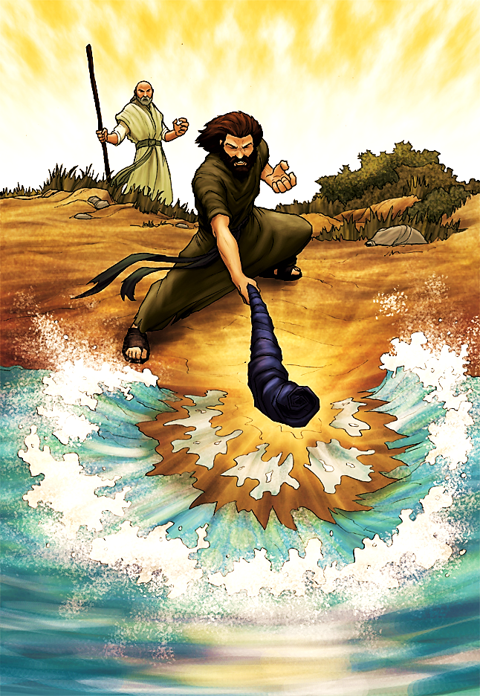
The Faith of our Fathers & Mothers is CAUGHT.
“Elijah took off his coat, folded it, and hit the water with it. The water separated to the right and to the left. Then Elijah and Elisha crossed the river on dry ground.” 2 Kings 2:8

Slide 19
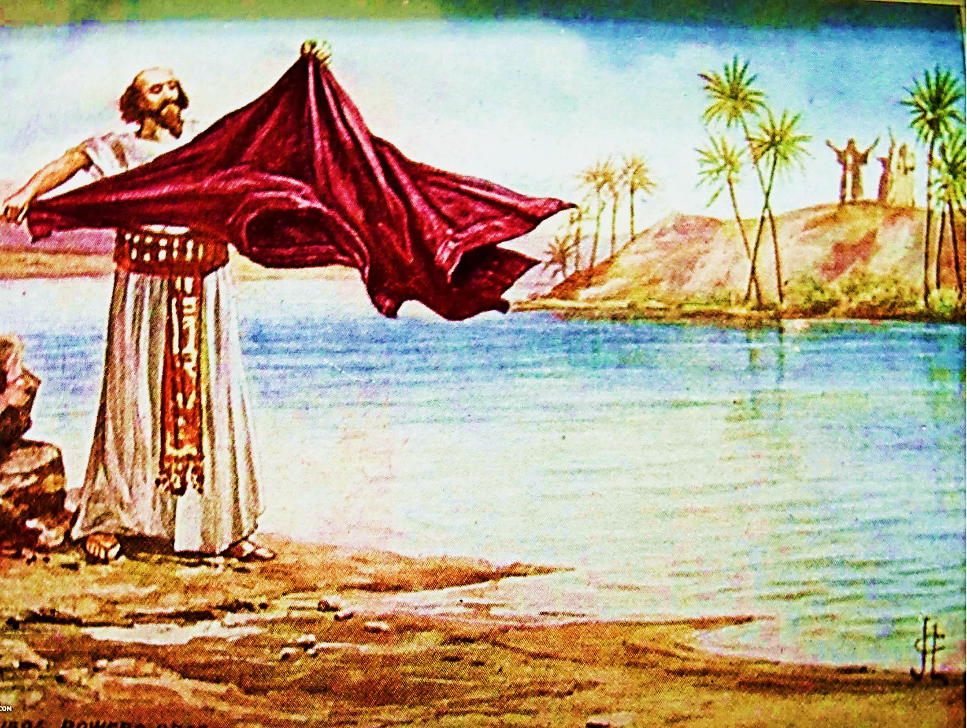
“Elijah’s coat had fallen to the ground, so Elisha picked it up. He went back and stood at the edge of the Jordan River. He hit the water and said, “Where is the Lord, the God of Elijah?.”
2 Kings 2:13, 14

Slide 20
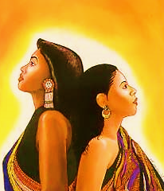
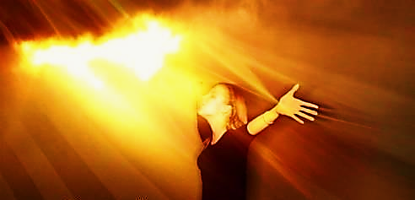
“I remember your honest and true faith. It was alive first in your grandmother Lois and in your mother Eunice. And I am certain that it is now alive in you also.”
2 Tim.1:5

Slide 21
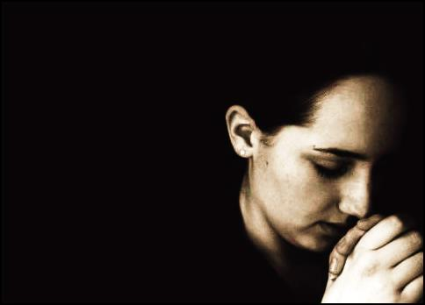
“She must be known for the good she has done: raising children, welcoming travelers into her home, serving the needs of God’s people, helping those in trouble, and using her life to do all kinds of good.” 1 Tim. 5:10

Slide 22
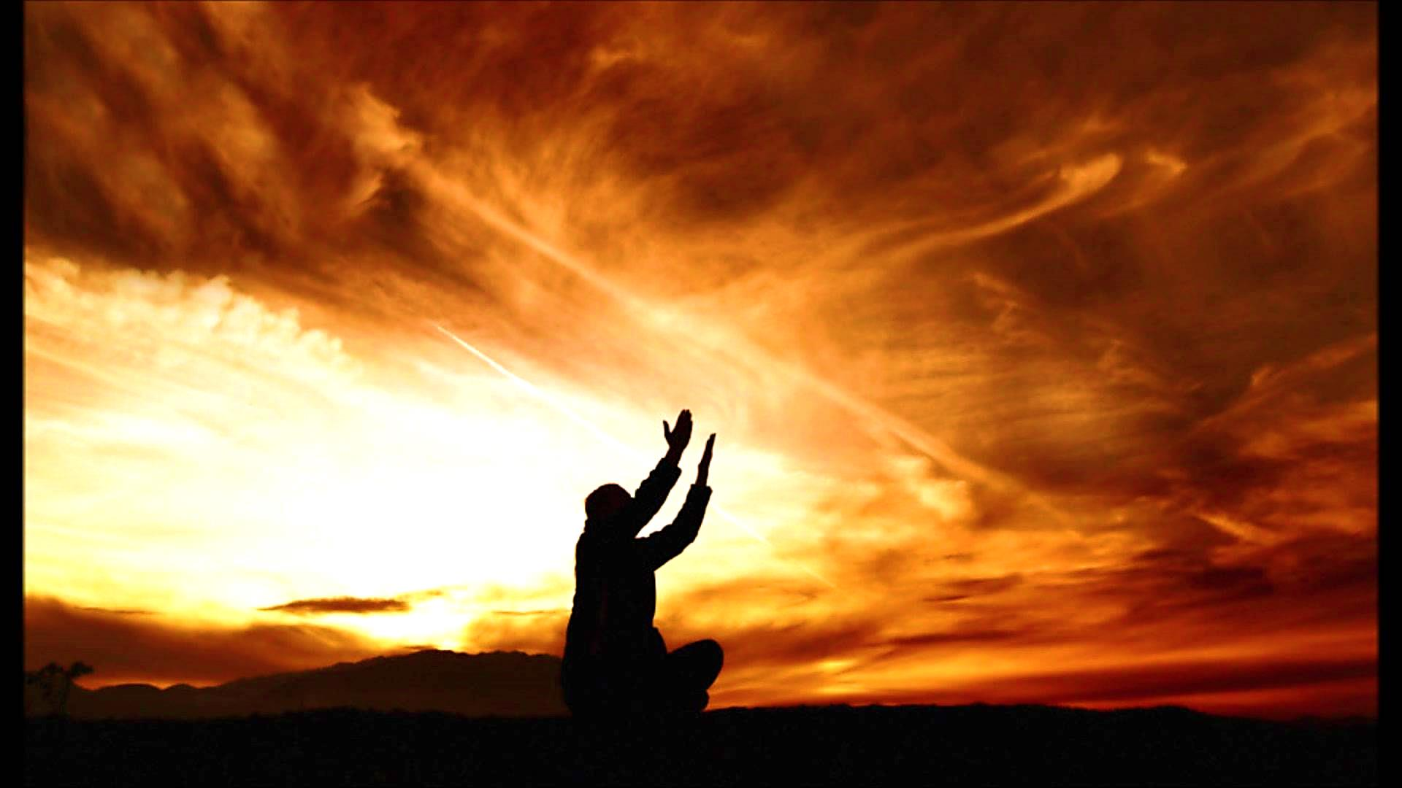
“Show that you hear me and be kind to me. I am your servant, so give me strength. I am your slave, as my mother was, so save me!” Ps. 86:16

Slide 23
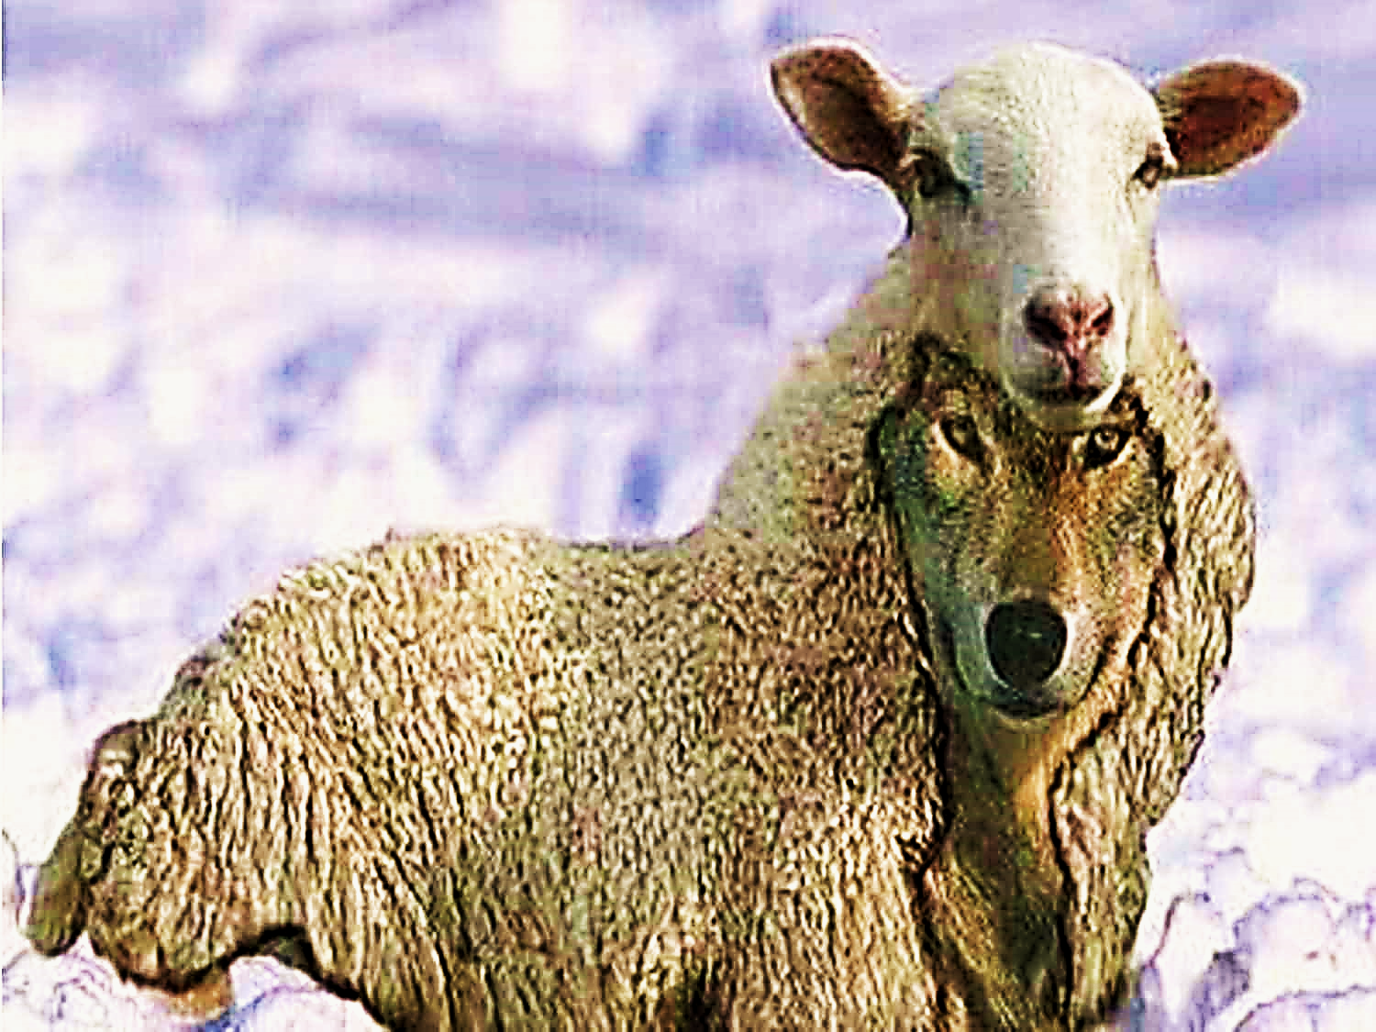
The Faith of our Fathers & Mothers Will Be FOUGHT.
“I know full well that after I leave you, false teachers, like vicious wolves, will appear among you, not sparing the flock.” Acts 20:29

Slide 24
“From my earliest youth my enemies have persecuted me, but they have never defeated me.” Ps. 129:2
“We have troubles all around us, but we are not defeated. We often don’t know what to do, but we don’t give up.” 2 Cor. 4:8, 9
“They will attack you, but they won’t defeat you, because I am with you and will rescue you, declares the Lord.” Jer. 1:19

Slide 25
Faith of Our Fathers & Mothers About Generational Faith – It is…
Bought | Taught | Caught | Fought
“But from everlasting to everlasting, the LORD's mercy is on those who fear him. His righteousness belongs to their children and grandchildren.” Ps. 103:17

Slide 26
Next Slide → Song:
My Mother’s Faith
Download Here:
http://youtu.be/JQJwlNqLNnQ

Slide 27
Next Slide → Song:
Helen Baylor's Testimony - Praying Grandmother
Download Here:
http://youtu.be/ArSzBE9e1pw

Slide 28
Next Slide → Song:
Find Us Faithful
Download Here:
http://youtu.be/s392HyzQ79M

Slide 29
Is Jesus Speaking to You?
“They said to each other, ‘Did not our hearts burn within us while he talked to us on the road, while he opened to us the Scriptures?’”
John Wesley Said:
“…the preacher was describing the change which God works in the heart through faith in Christ and I felt my heart strangely warmed.”
Jesus makes His presence Known by a small voice!

Slide 31
What is the Sinner‘s Prayer?
This is a prayer we can pray when we are ready to admit we are sinners and need Christ’s forgiveness.
It must be prayed with faith in our hearts and a readiness to have a life-changing encounter with Jesus Christ.

Slide 32
A prayer of faith → Pray this prayer if :
If you never have before
You have in the past, but you think it would mean more today
You have been walking afar off and you want to come back
You want to set an example & show others how it is done
You just like to give your heart to Jesus again & again
Faith

Slide 33
We Declare Our Faith Publicly Because Jesus Declared His LOVE Publicly
“If you stand before others and are willing to say you believe in me, then I will tell my Father in heaven that you belong to me.” Mat 10:32

Slide 34
Important Questions
Do you want to know Jesus as your Savior right now?
Do you believe He died to save you from your sins & that He rose from the dead?
Do you believe that He is here, waiting to save you right now?

Slide 35
The Prayer of a Sinner Turning to Jesus
Dear Jesus, I know that I have sinned against You and that my sins separate me from You.
I am truly sorry.
Right now, I turn away from my sinful past .
Please forgive me, and help me to keep from sin.
I believe You died for my sins.
I Believe You rose from the dead, you are alive, and you hear this prayer from my heart.
I invite You Jesus to be both my Savior and the Lord of my life.
I want You to rule my life from now on.

Slide 36
“But some people did accept him. They believed in him, and he gave them the right to become children of God.”
John 1:12

Slide 38
“If you openly say, ‘Jesus is Lord’ and believe in your heart that God raised him from death, you will be saved.”
Rom. 10:9
What did you learn today?
What is the meaning of the name-tag?
What have you been thinking about God lately?
What do you want to tell the world about Jesus?

Slide 39
“Draw near to God, and He will draw near to you…
Altar Time
…Cleanse your hands, you sinners, and make your hearts pure, you who are half-hearted towards God.” James 4:8 WNT

Slide 40
Close in Prayer

Slide 41
Note: Any videos in this presentation will only play online. After you download the slideshow, you will need to also download the videos from YouTube & add them back into your PowerPoint.
We present these messages at Bee Creek Park in College Station, TX. If you would like to watch the video of the service with this message, click here:
http://campaignkerusso.org/?p=11695
We would love to know more about the people who download our lessons & sermons. We invite you to email us & let us know where & how you use them.
info@ckbrazos.org

Slide 42
Welcome to Aggieland Faith Family Style Worship

Slide 43
CURRENT SCHEDULE: www.Aggielandfaith.org
Three Sunday Sermons
From 2 pm till about 4 pm
Through the New Testament
Through the Old Testament
Topical or Series
(Current Series: Tabernacle)

Slide 44
Would You Like Prayer or Bible Study at Your House?
Personal Prayer: We can come to your home & pray with you, or you can email us when you need prayer.
Home Bible Study: We will come to your home & hold a bible study for you & your friends.
Bible Party: We will hold a Kid’s Bible Party: You provide the food & kids - we will do the bible fun & stories.

Slide 45
Would You Like Visitation?
We will visit a friend, loved one in the hospital or in prison to pray for them & share Christ with them.
Contact: info@aggielandfaith.org

Slide 46
www.aggielandfaith.org
Go here to see pictures & videos
Go here to subscribe to e-mails about changes & cancellations

Slide 47
Note: Any videos in this presentation will only play online. After you download the slideshow, you will need to also download the videos from YouTube & add them back into your PowerPoint.
We present these messages at Bee Creek Park in College Station, TX. If you would like to watch the video of the service with this message, click here:
http://campaignkerusso.org/?p=11695
We would love to know more about the people who download our lessons & sermons. We invite you to email us & let us know where & how you use them.
info@ckbrazos.org

